Slide 1
Azure Function App Health
Or Abusing the Azure Functions Runtime for fun and profit

Slide 2
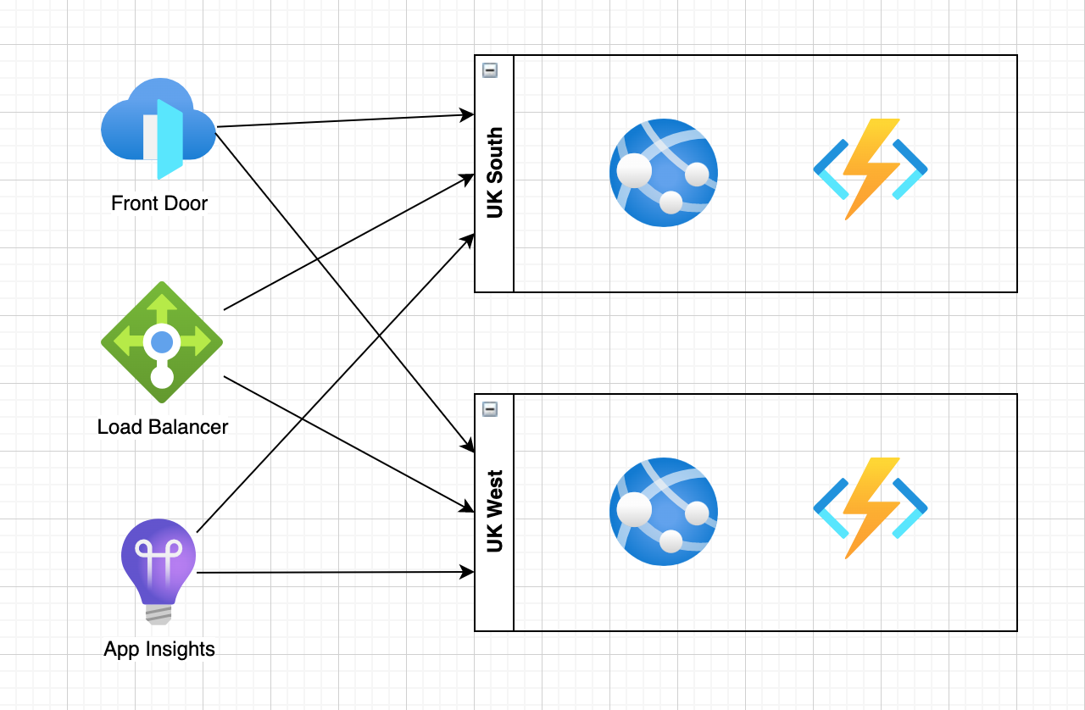
Health Check Endpoint Pattern

